Slide 1

Web Server and VPN Setup using Cisco Packet Tracer
Exploring Network Configuration for Secure Remote Access
PREPARED BY-
NAVJOT KAUR CHEEMA
UNI. ROLL No.-2100374
(BBSBEC)

Slide 2

Web Server Overview:
A web server is a software or hardware system that delivers web content, such as web pages, images, and multimedia, to clients over the internet. It plays a crucial role in making websites and applications accessible to users. Whether you're browsing your favorite online store or checking the latest news, a web server handles the requests and responses that power your online experience.

Slide 3

VPN Introduction
A Virtual Private Network (VPN) is a technology that establishes secure and encrypted connections over a public network, usually the internet. It enables users to access private networks remotely as if they were directly connected to the network, ensuring privacy, confidentiality, and data integrity. VPNs are widely used in scenarios where data security is paramount, such as remote work, branch office connectivity, and maintaining secure communication channels.

Slide 4

Significance of Setting Up Web Servers and VPN
As the world becomes increasingly interconnected, the need for secure remote access to resources has never been more critical. Businesses and individuals alike rely on web servers to deliver content and services to users globally. However, ensuring that these interactions occur securely is equally important. This is where VPNs come into play. By setting up a VPN, organizations can create encrypted tunnels for data transmission, preventing unauthorized access and eavesdropping.

Slide 5
Cisco Packet Tracer
Our presentation will be facilitated by Cisco Packet Tracer, a powerful network simulation tool. It allows network administrators, students, and enthusiasts to design, configure, and troubleshoot network setups in a virtual environment. Packet Tracer enables hands-on learning and experimentation without the need for physical hardware, making it an ideal tool to understand and practice various networking concepts.
In the subsequent slides, we'll delve into the specifics of designing, configuring, and testing a web server and VPN setup using Cisco Packet Tracer. Let's explore the exciting world of network configuration for secure remote access!

Slide 6
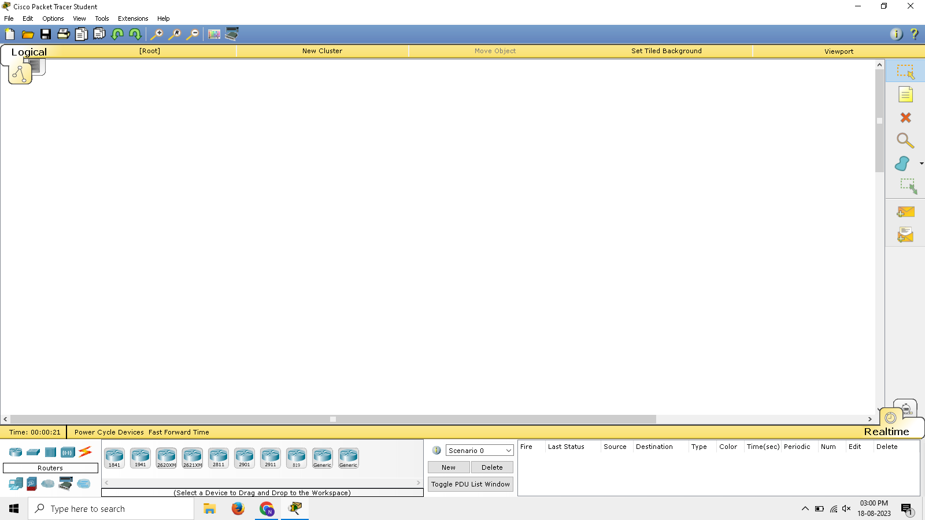
Cisco Packet tracer interface

Slide 7
Steps for implementation of basic network with web server
Go to end devices
Choose server
Connect server to switch using straight cable
Give IP address to server(Range of IP should be similar to that of switch it is connected to)
Go to services and click HTTP
Click index.html then edit as per requirement of server
Make all other servers as per requirement and check it's working by browsing on any PC in network

Slide 8
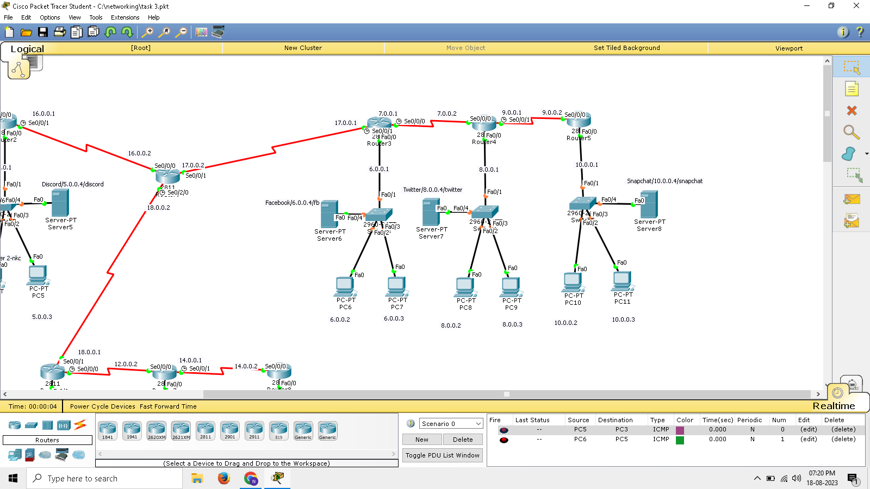
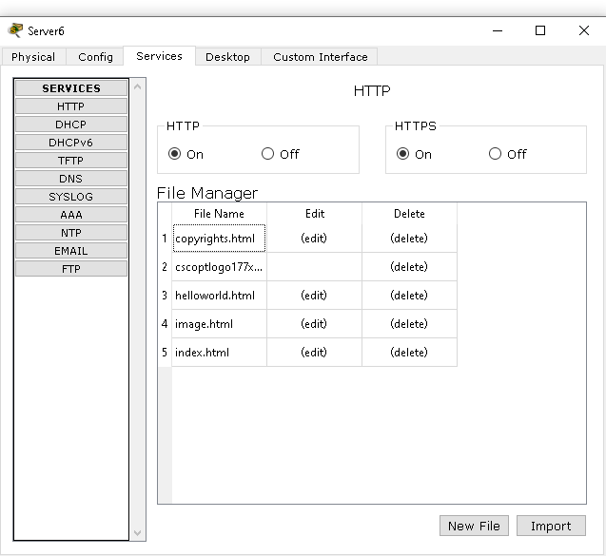
Network design for each web server room
Network with various servers
HTTP Service

Slide 9
Steps for implementation of dns server
Take one server and connect to any switch in the network
Give IP address to DNS Server
Go to services then DNS and switch on DNS
Give name of web services and ip of web server then click add
Provide name for all web server IP for different services

Slide 10
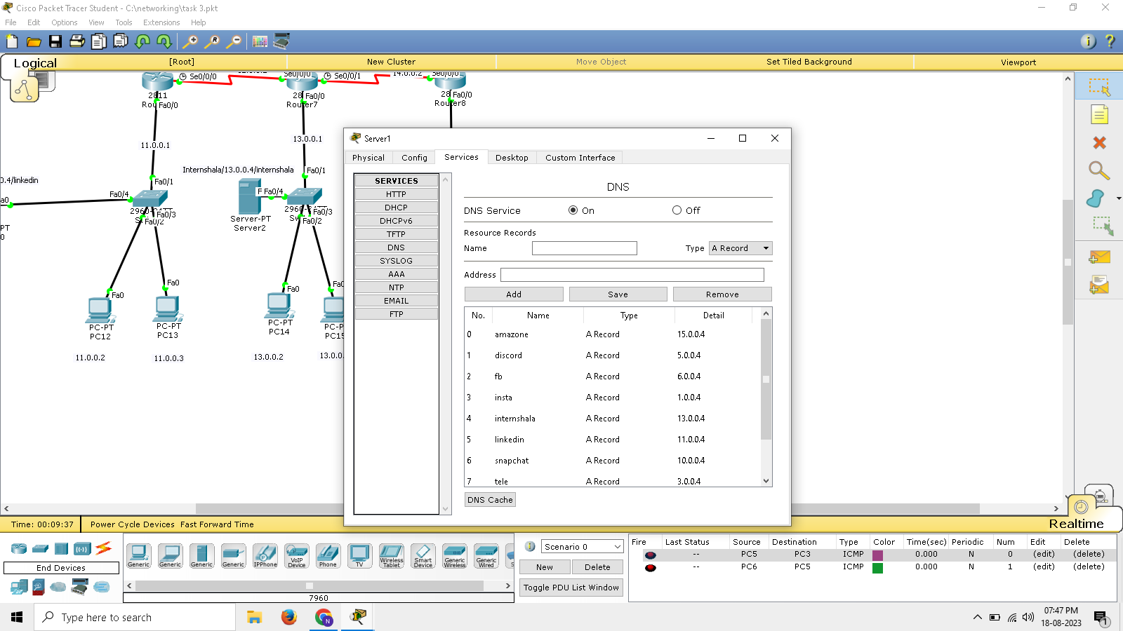
dns server interface

Slide 11

Steps for implementation of basic network with email server
Select server from end devices
Go to services and select email
Give domain name and then click set.Eg-abc.com
Define username and give password
Click +
We can add multiple users as per requirement
Select any PC within network and select email
Fill out details and start composing mails.

Slide 12
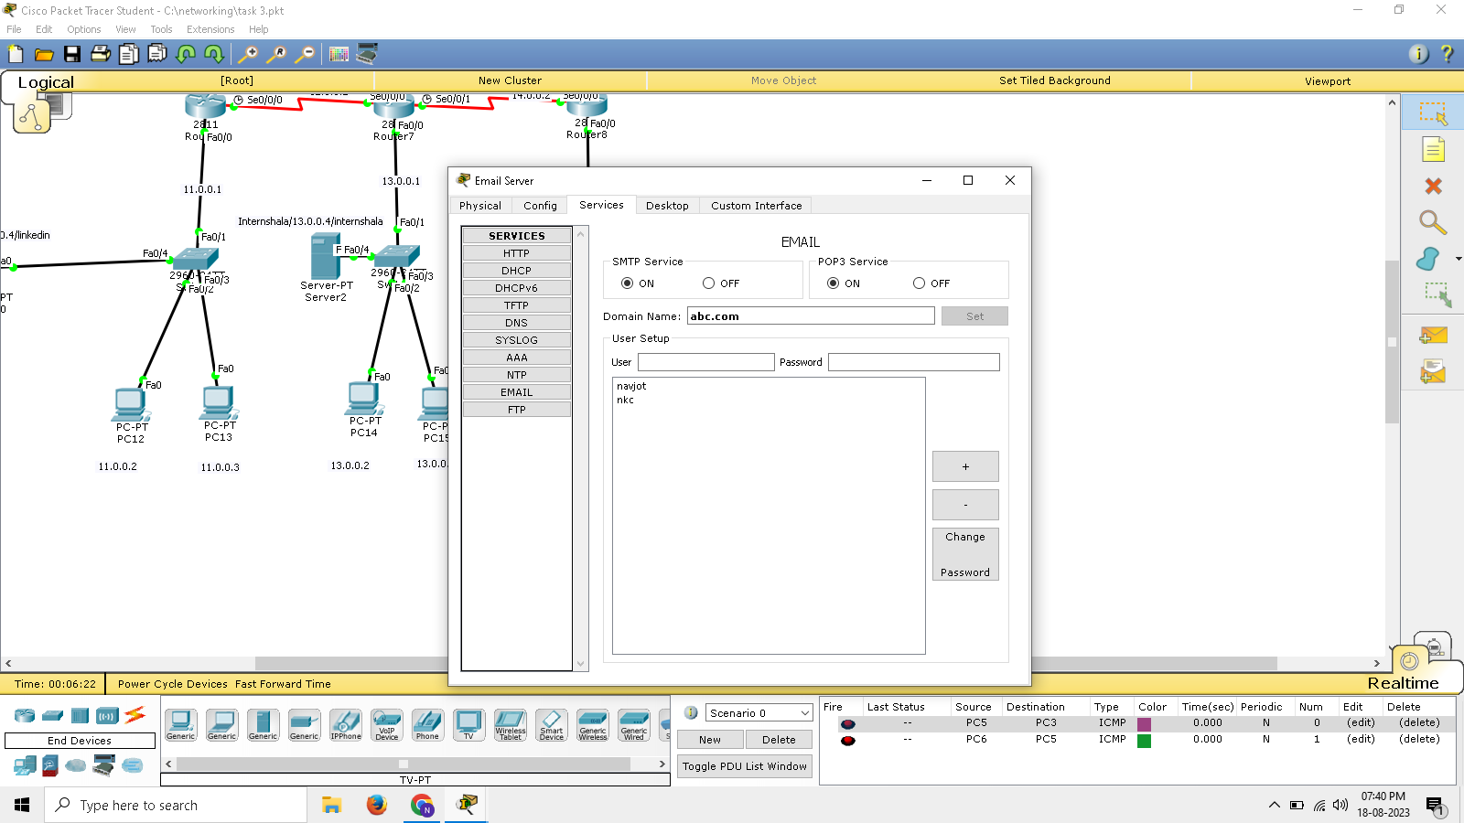
Email server interface

Slide 13
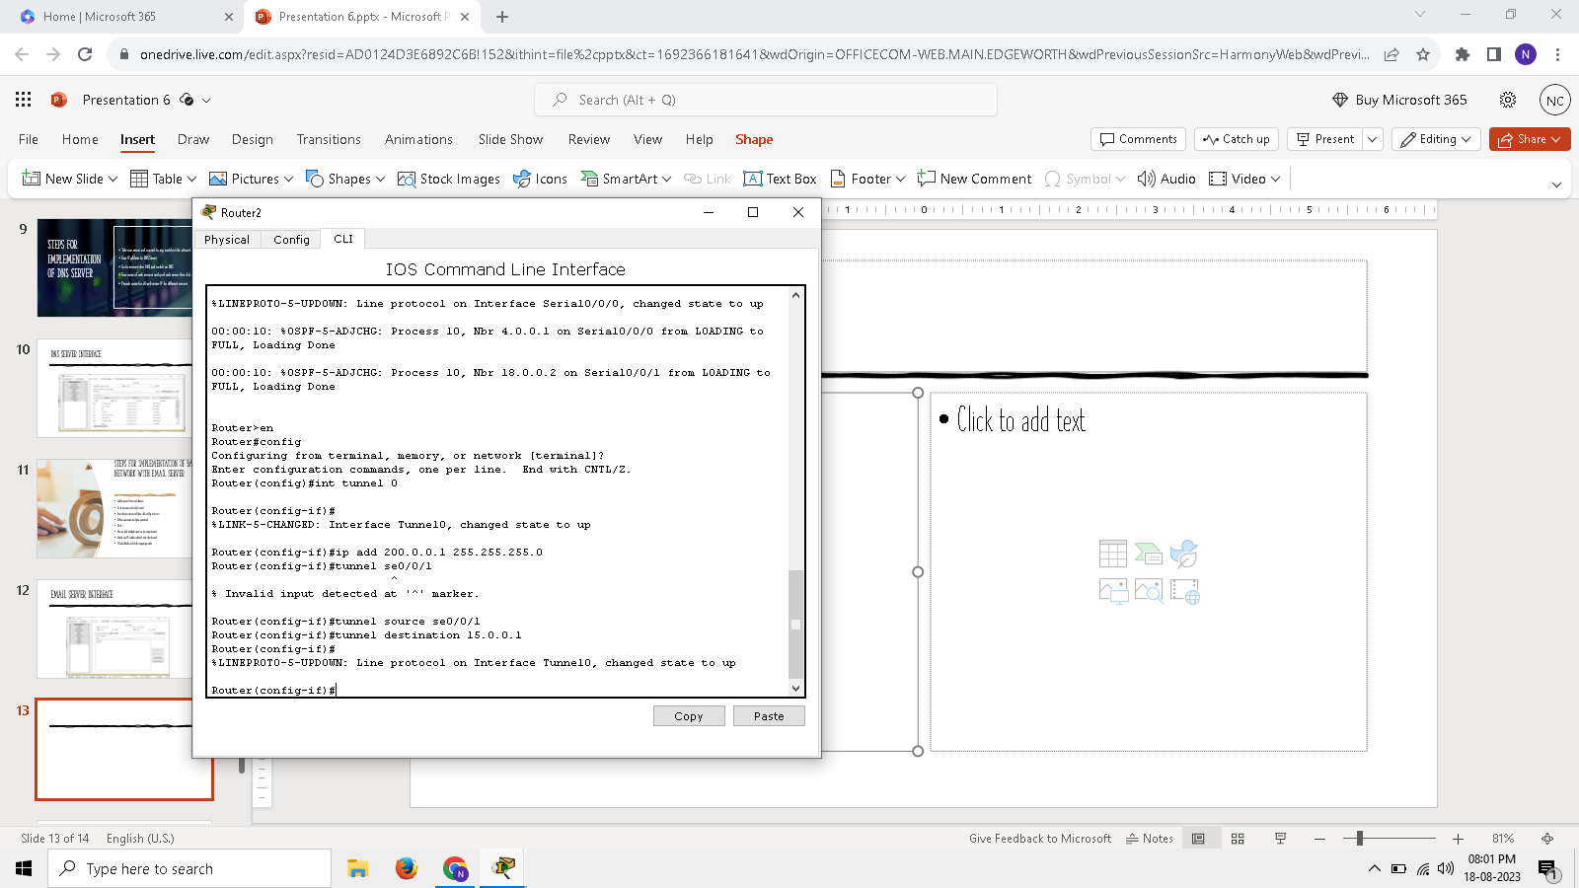
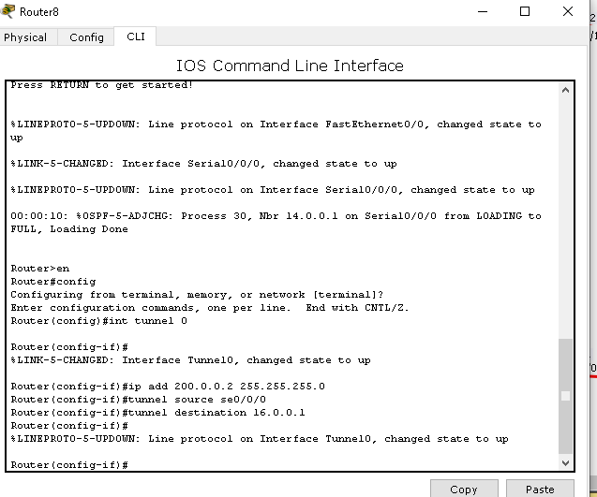
Implementation of vpn
Commands in Router 1
Commands in Router 2

Slide 14
benefits of using a VPN
Privacy and Anonymity: Encrypts traffic, hides IP address.
Data Security: Protects data on public Wi-Fi.
Geo-Restriction Bypass: Access blocked content by changing virtual location.
Circumvent Censorship: Access restricted websites in certain countries.
Public Wi-Fi Safety: Secures data on unsecured networks.
Remote Access: Securely connect to work networks from anywhere.
Cyber Threat Protection: Guards against hacking, phishing, and attacks.
Reduced Tracking: Minimizes online tracking and targeted ads.
Secure Transactions: Adds extra security for online payments.
Multi-Device Support: Protects various devices under one subscription.
Privacy on Public Networks: Safeguards data on open networks.

Slide 15
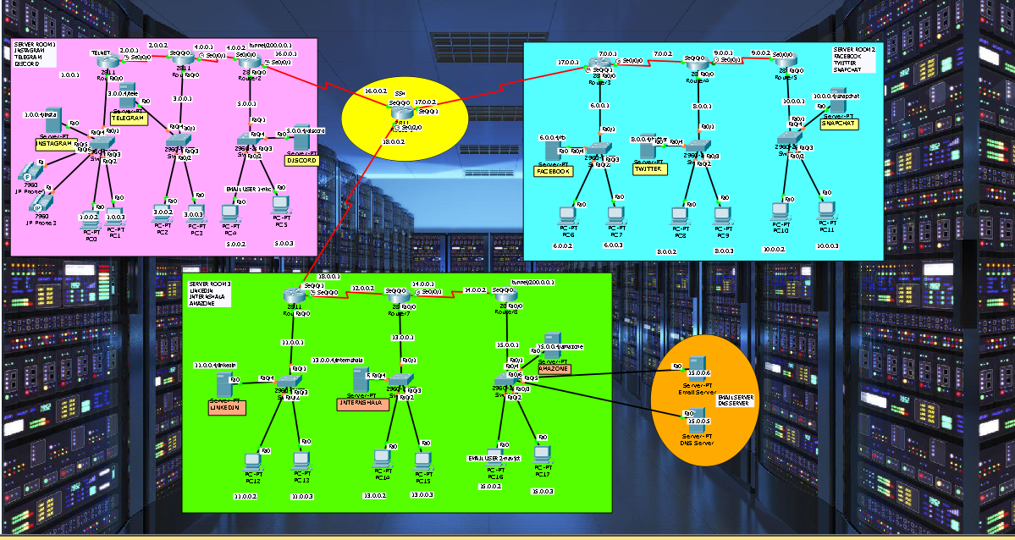
Network with web server ,dns server ,email server and vpn implementation

Slide 16
Thank you!

